Slide 1

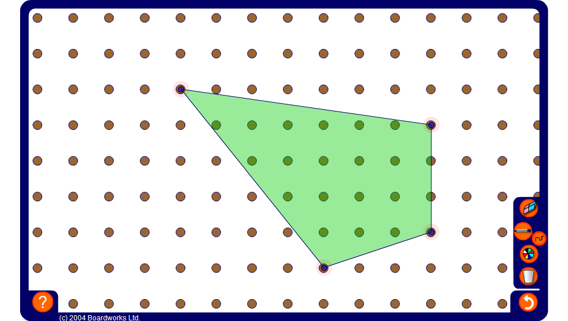


Area of an irregular shape on a pegboard
Notes:
Drag the vertices to modify the shape. Ask a volunteer to divide the shape into rectangles and triangles using the pen tool set to draw straight lines. Use this to work out the area.
Alternatively, draw a rectangle around the outside of the shape to find the area by subtraction.

